Slide 1
System Panic
Presenters
Antony Pinto
Alek Martinez

Slide 2
Agenda
Art Updates
Intersection Updates
Backend Work
Leveling System
Attribute Upgrade System
Up Next

Slide 3
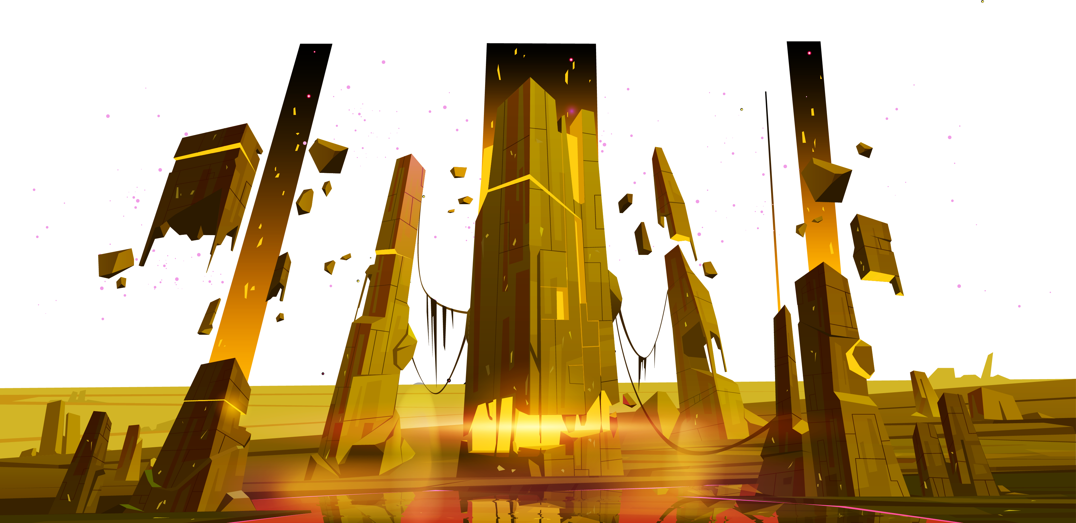
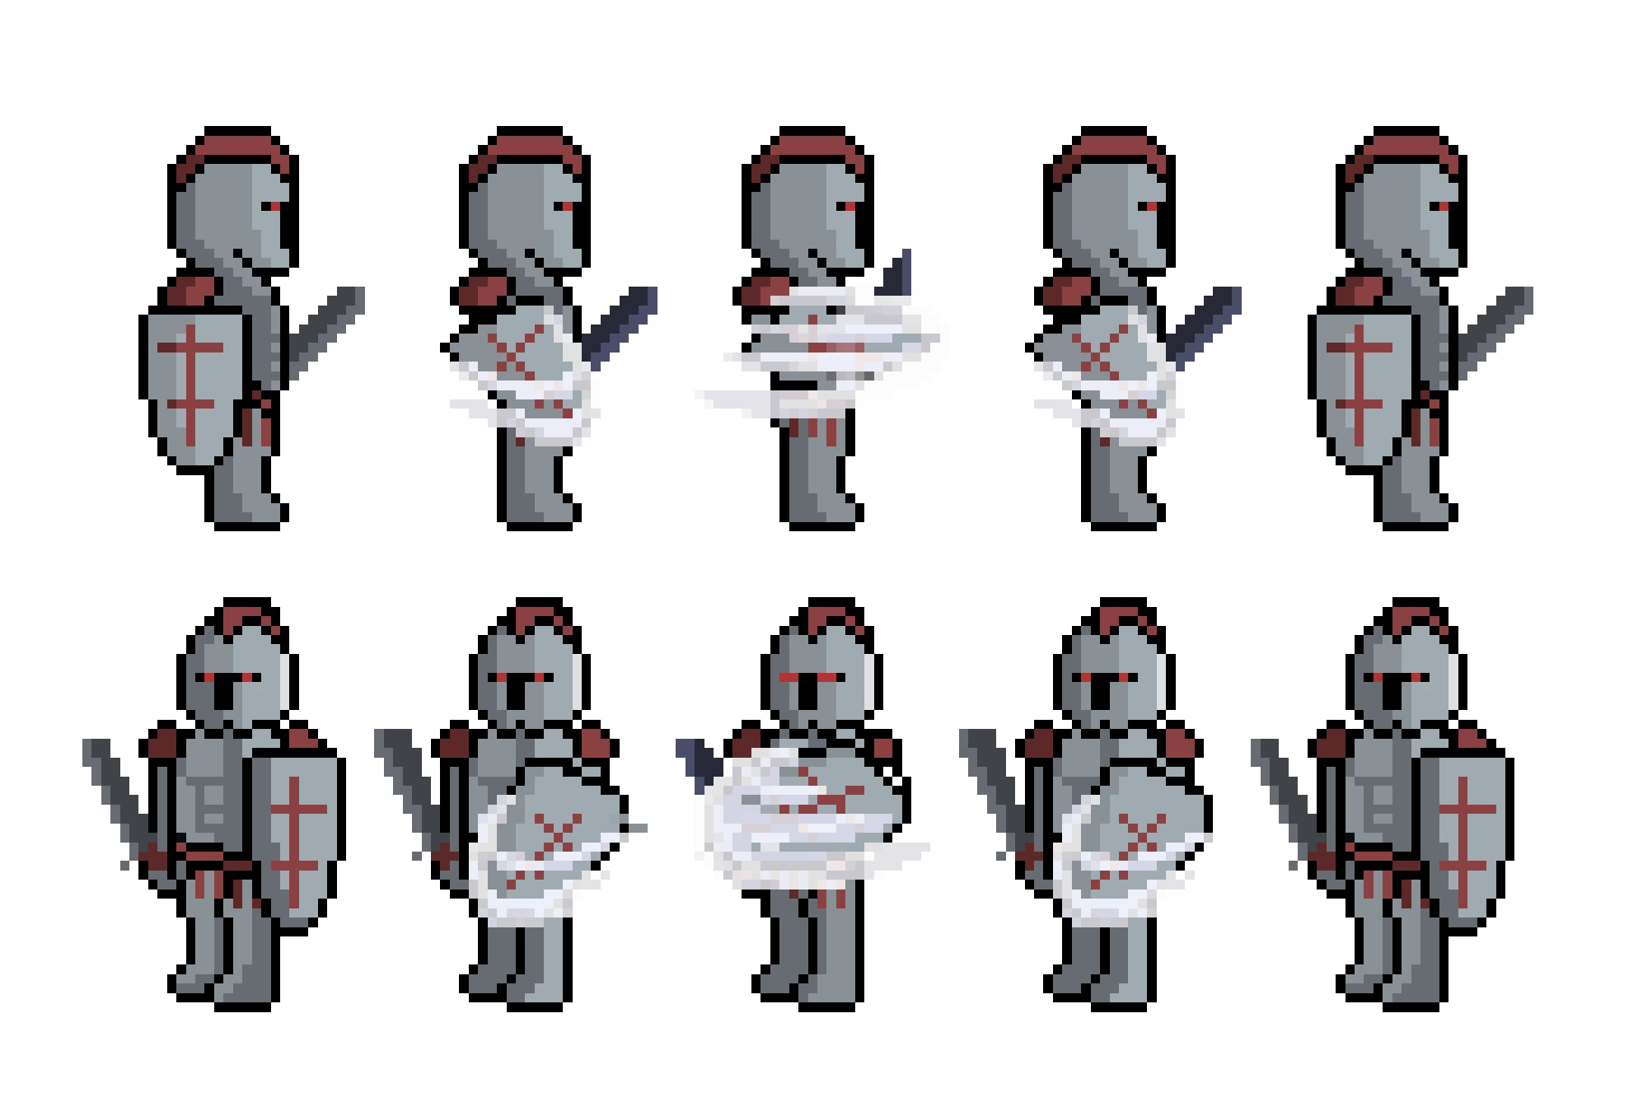

Art Updates
Character Class - Tank
UI – Borders and Icons
Modifications in progress
Aiming for a more plain clothes style, with D&D inspired elements
More on the way
Testing out different styles

Slide 4
Intersection Updates
New intersections made last week

Slide 5
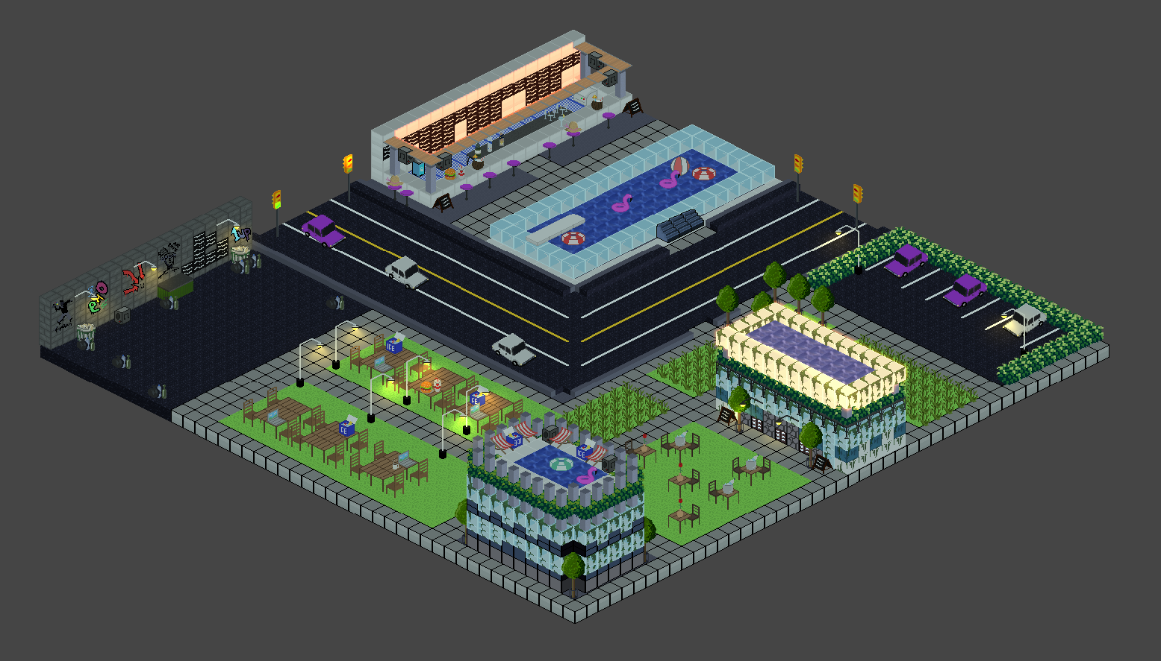
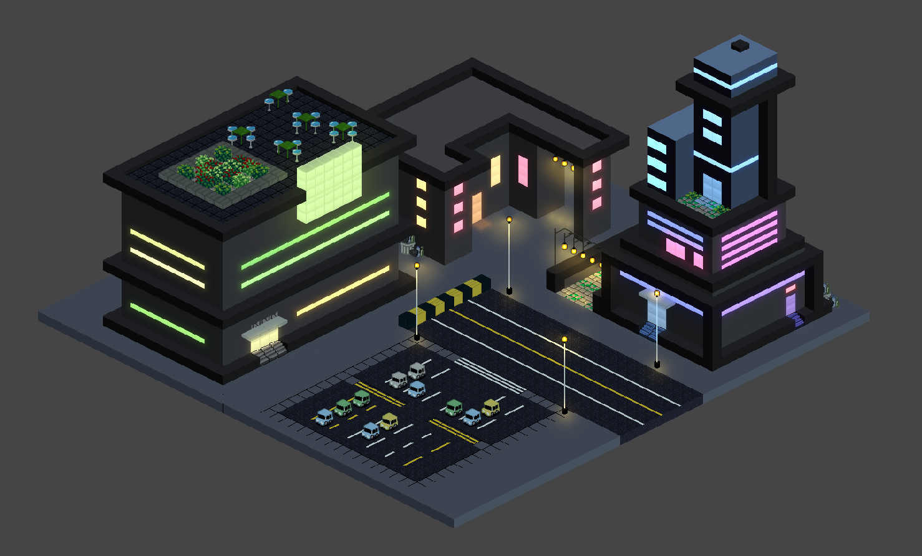
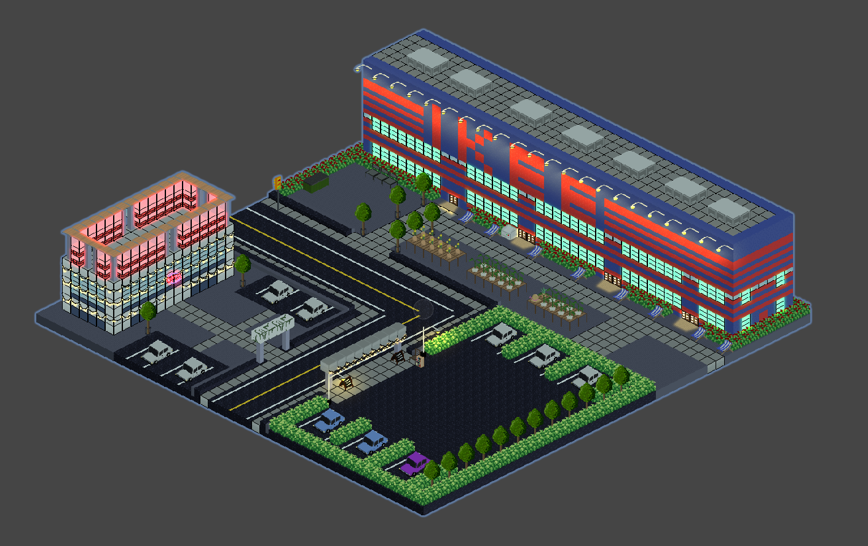
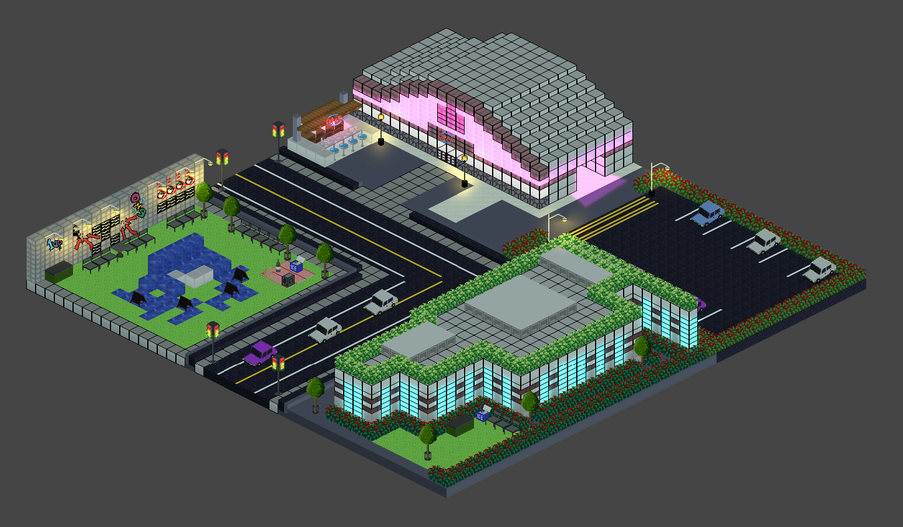
😉

Slide 6
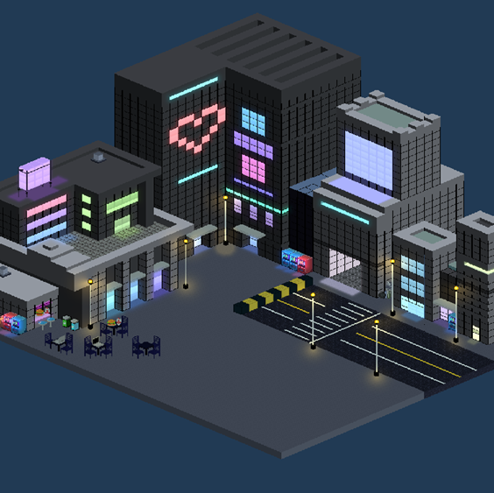
Backend Work
This week, the team was heavily focused on backend work, so there aren’t as many visual updates as we’d like to show.

Slide 7
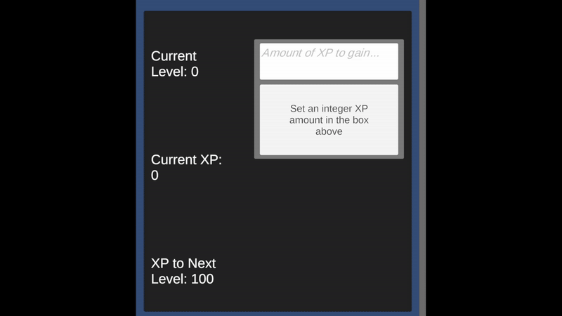
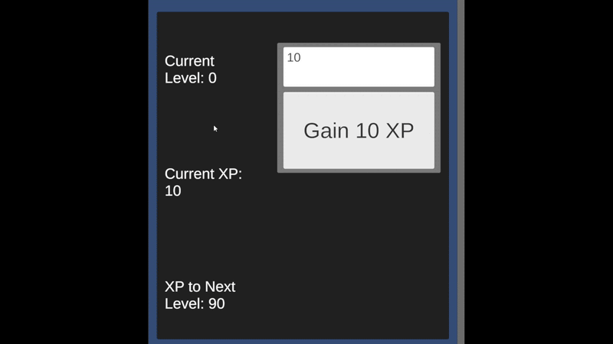
XP
Scaling
Player gains experience points by winning in combat. They will be able to see how much XP they’ve gained this Level, as well as the amount until they level-up
Every time the player levels-up, the amount of XP required to reach the next level will increase
Dev Tool – Level Testing

Slide 8
Character Upgrade Loop
Player Wins in Combat
Player gains XP
Player levels-up
Player gains Attribute Points
Player increases Attributes
Stats are affected by Attributes

Slide 9
Character Upgrade Sandbox
For balance testing
Lays the groundwork for the in-game Attribute Upgrade system
UI
We are aware it looks rough – it is!
Purely functional

Slide 10
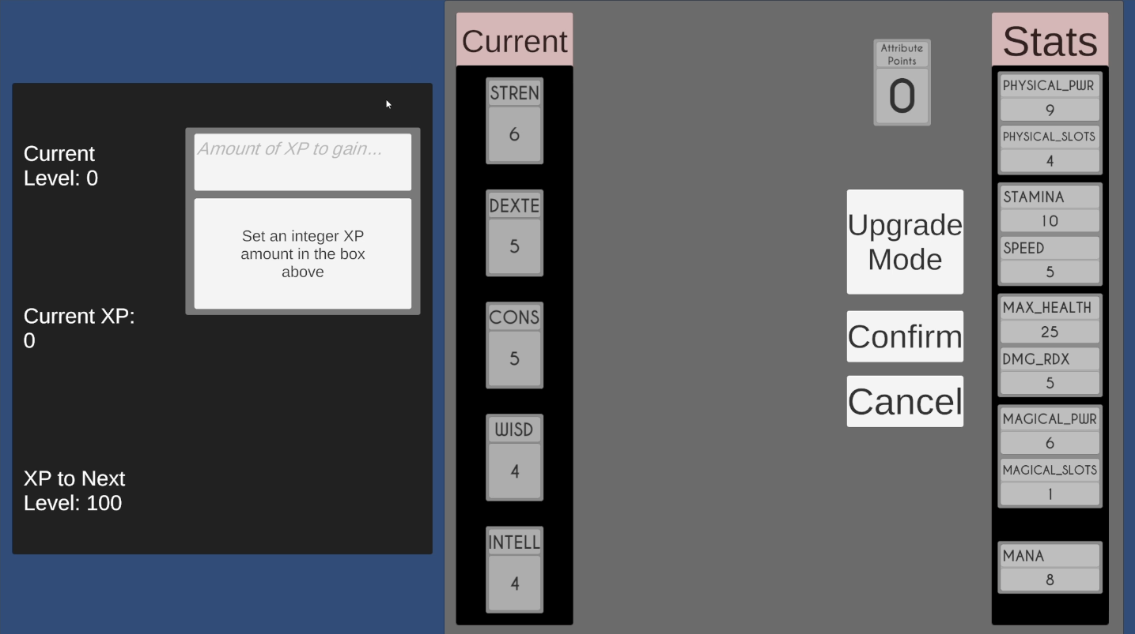
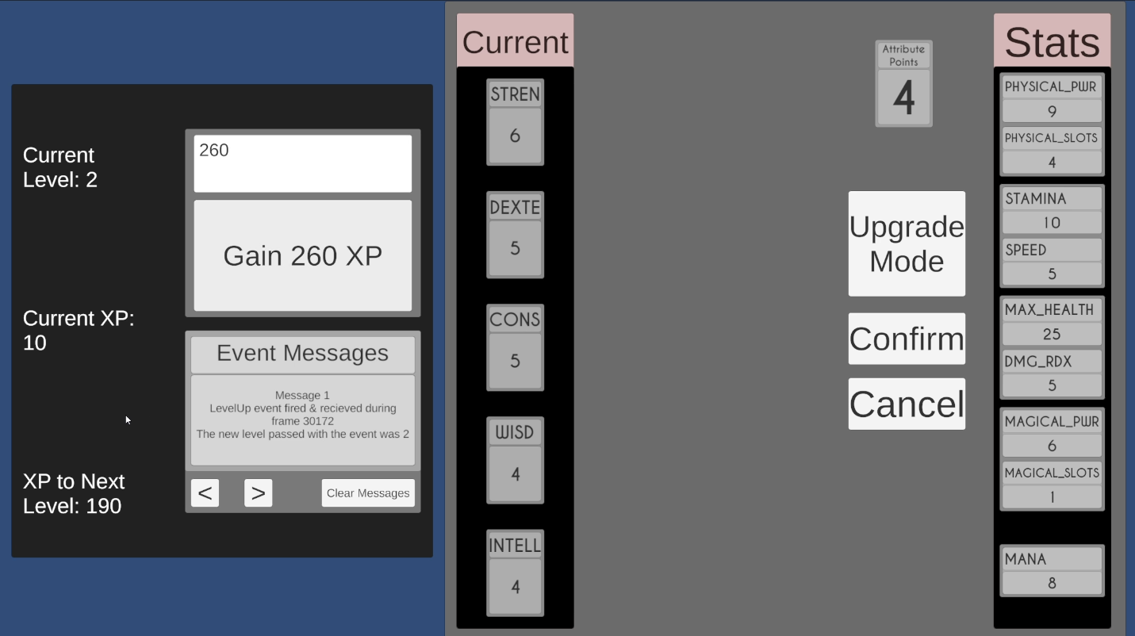
Character Upgrade Sandbox
For every new level, the XP to the next is increased by 50.
0 Attribute points because we are level 0.
Gain 2 attribute points per level.
Gained 260 XP
Went up 2 levels.
Gaines 4 attribute points.
Left with 10 current XP, and 190 XP to next level.

Slide 11
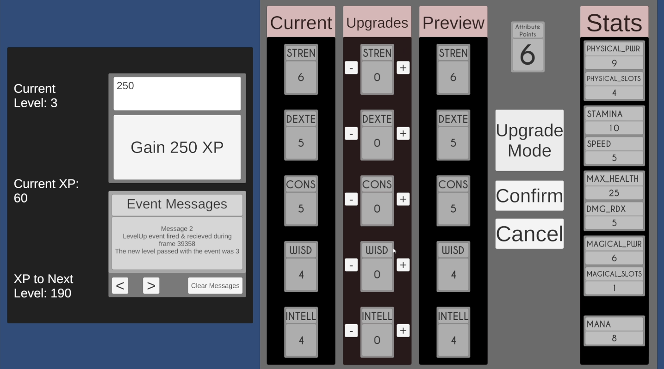
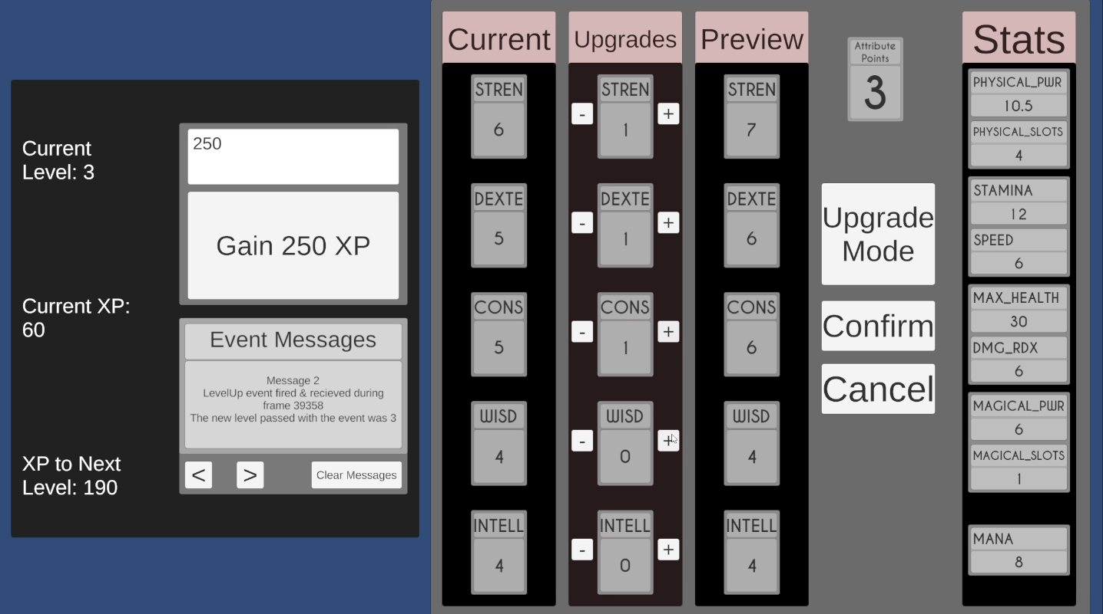
Character Upgrade Sandbox
Entered Upgrade mode
When + is pressed, it previews the changes.
Attributes directly affect stats.
If – is pressed when 0, a message will appear.
If + is pressed with 0 attribute points, a message will appear.

Slide 12

Character Upgrade Sandbox
After applying the points, the player can confirm or cancel the changes.
If cancelled, attribute points are refunded.
If confirmed, attribute points are spent and cannot be retrieved.
After confirming, stats are permanently changed, (except if you die ofc).

Slide 13
Up Next
Character Art
Level Design Adjustments
Upgrade System Implemented
Player Inventory System
NPC Interactions
Quests
Shops

Slide 14
Thanks!
Questions? Feedback?

